Slide 1




NEXT GEN EMPLOYABILITY PROGRAM
Creating a future-ready workforce
Team Members
College Name
Student Name :A VIDHYA Kingston Engineering College
Student ID :511321104110

Slide 2

CAPSTONE PROJECT SHOWCASE
Project Title
Building Bus Reservation System using Python and Django
Abstract | Problem Statement | Project Overview | Proposed Solution | Technology Used | Modelling & Results | Conclusion

Slide 3
Abstract
In today's fast-paced world, efficient transportation systems play a crucial role in ensuring smooth mobility for individuals and goods. Bus reservation systems are pivotal in managing the complexities of bus travel, offering convenience to passengers while optimizing operations for service providers. This abstract outlines the development of a robust bus reservation system leveraging the power of Python programming language and the Django web framework.
Source :

Slide 4
Problem Statement
The transportation sector, specifically bus travel, faces numerous challenges in providing efficient and convenient services to passengers. Traditional booking systems often lack user-friendly interfaces, real-time information updates, and robust management capabilities. To address these challenges, there is a need for the development of a modern Bus Reservation System leveraging Python and Django technologies.
Source :

Slide 5
Project Overview
serves as a primary mode of travel for many individuals and requires effective management to ensure a seamless experience for passengers. This project aims to develop a comprehensive Bus Reservation System using Python and Django, providing users with a modern, user-friendly platform for booking bus tickets, managing routes, and monitoring bus schedules.
1.Design a user-friendly interface
2.Implement user authentication and authorization
3.Integrate real-time tracking
4.Develop robust administrative features
5.Integrate secure payment gateways
6.Implement reporting and analytics
Source :

Slide 6
Proposed Solution
.
The proposed solution involves developing a Bus Reservation System using Python programming language and Django web framework. The system will address the aforementioned challenges by providing a user-friendly interface for booking tickets, real-time updates on bus schedules and availability, automated administrative tasks, secure payment integration, and robust data management capabilities.
Source :

Slide 7
Design a user-friendly interface: Develop an intuitive web interface for passengers to search for buses, view schedules, select seats, and make bookings easily.
Implement user authentication and authorization: Enable users to register, log in securely, and manage their bookings, while ensuring data privacy and security.
Integrate real-time tracking: Incorporate GPS technologies to enable passengers to track bus locations in real-time, reducing wait times and enhancing travel convenience.
Develop robust administrative features: Implement functionalities for admins to manage bus routes, stops, schedules, and bookings efficiently through an administrative dashboard.
Integrate secure payment gateways: Enable passengers to complete transactions securely using multiple payment methods, ensuring a smooth booking experience.
Implement reporting and analytics: Develop reporting tools to generate insights into passenger preferences, booking patterns, and operational performance for informed decision-making.
Source :

Slide 8
Technologies Used:
Python: Utilize the Python programming language for backend development, leveraging its simplicity, versatility, and extensive libraries for web application development.
Django: Employ the Django web framework for rapid development of the Bus Reservation System, utilizing its built-in features for user authentication, database management, and template rendering.
HTML/CSS/JavaScript: Develop the frontend components of the web application using HTML for structure, CSS for styling, and JavaScript for interactive elements and dynamic content.
PostgreSQL: Use the PostgreSQL database management system to store and manage data related to bus routes, schedules, bookings, and user accounts securely.
RESTful APIs: Implement RESTful APIs to facilitate communication between the frontend and backend components of the application, enabling seamless data exchange.
Git: Utilize version control with Git to track changes, collaborate with team members, and manage project updates efficiently.
Project Timeline:
Source :

Slide 9


Technology Used
Front-end
Back-end
Source :

Slide 10
Modelling & Results
Database Schema Design:
Utilize PostgreSQL for database management.
Design database schema to store information about buses, routes, stops, schedules, bookings, and user accounts.
Backend Development:
Develop backend functionalities using Python and Django.
Implement user authentication and authorization mechanisms to secure user accounts and bookings
Frontend Development:
Design user-friendly interfaces using HTML, CSS, and JavaScript.
Integration and Testing:
Integrate frontend and backend components to create a cohesive web application.
Deployment and Optimization:
Deploy the Bus Reservation System to a production environment, ensuring scalability and reliability.
Results:
The Bus Reservation System provides users with a seamless booking experience, allowing them to search for buses, select seats, and make bookings with ease.
Passengers can track bus locations in real-time, reducing wait times and enhancing travel convenience
Source :

Slide 11
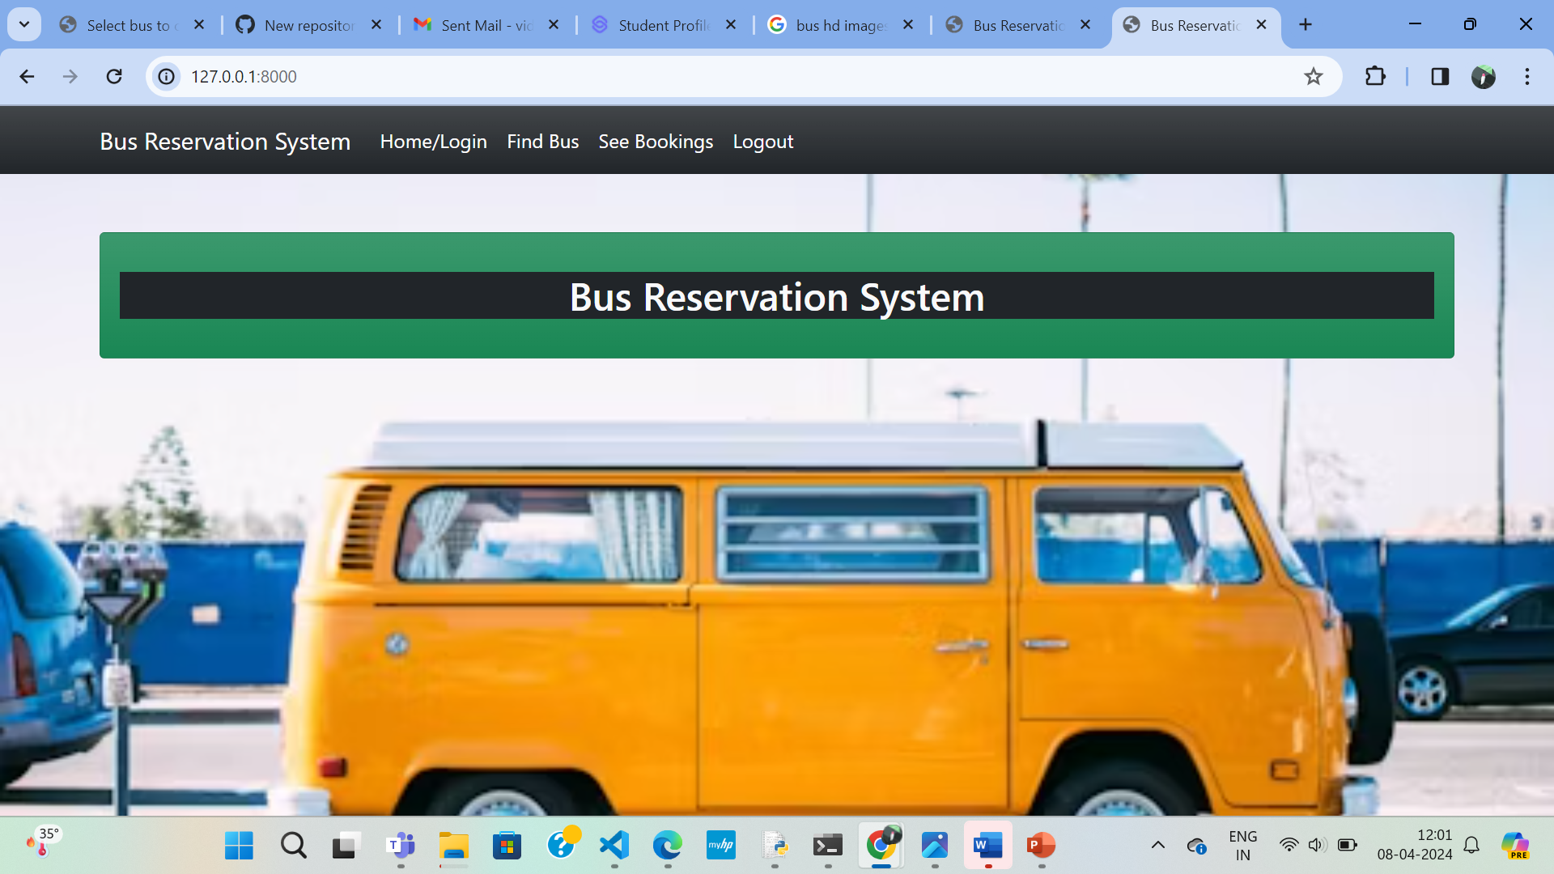
Homepage

Slide 12
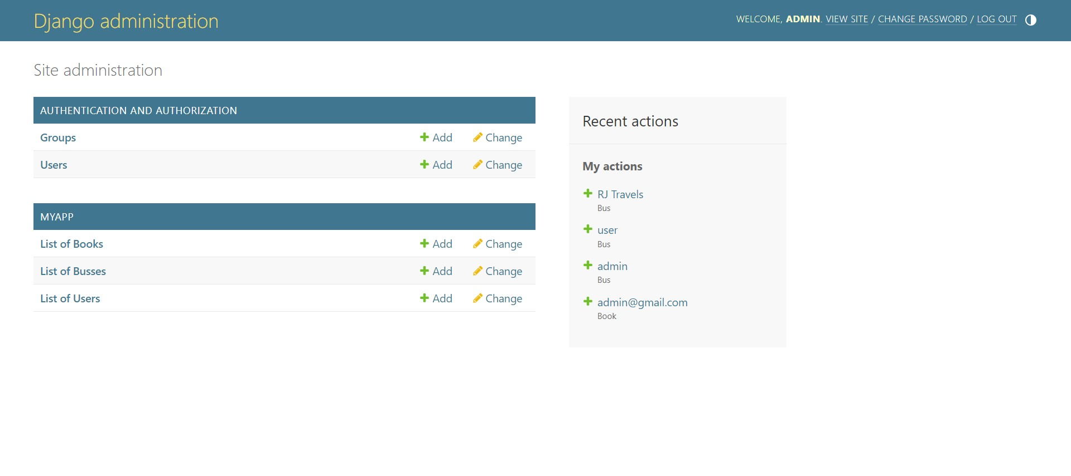
About-Us-Page

Slide 13
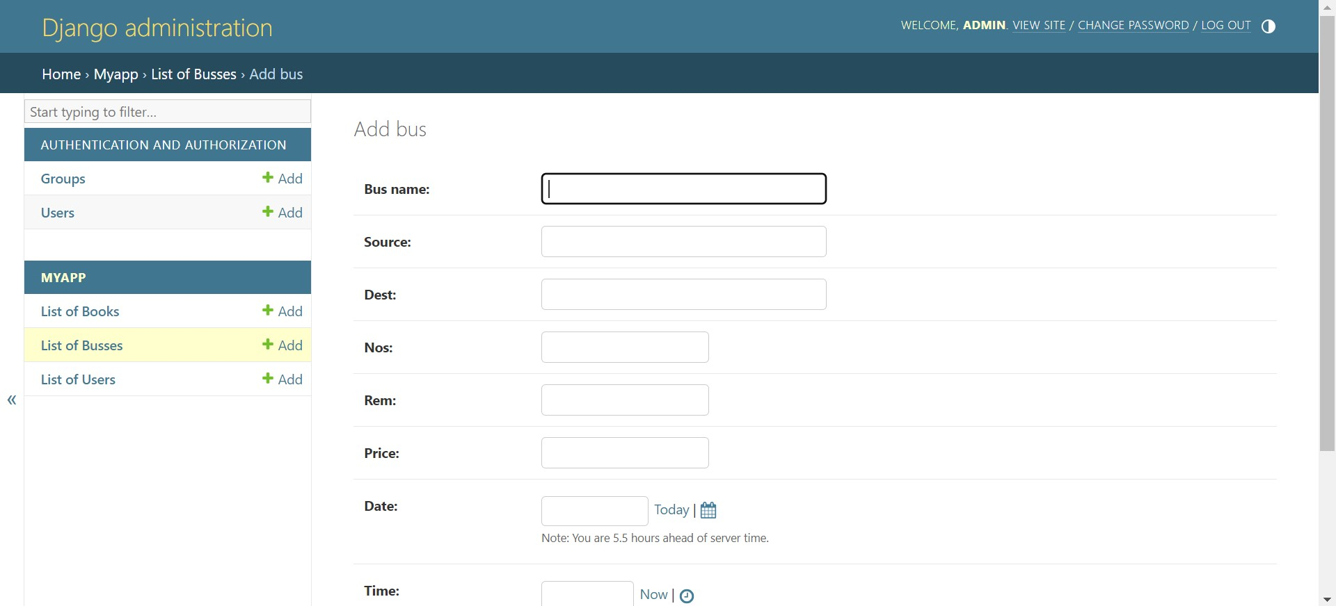
Service-Page

Slide 14
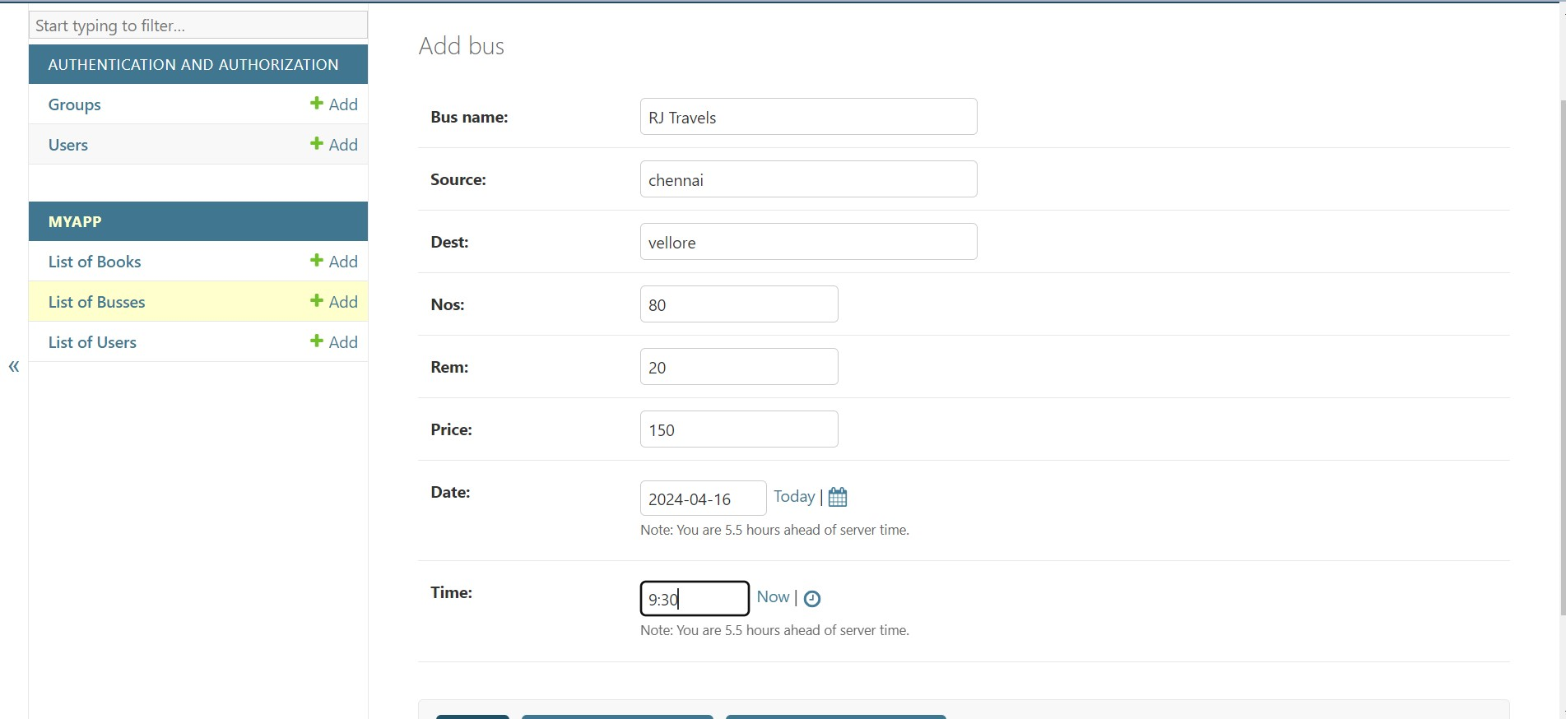
Departments-Page

Slide 15
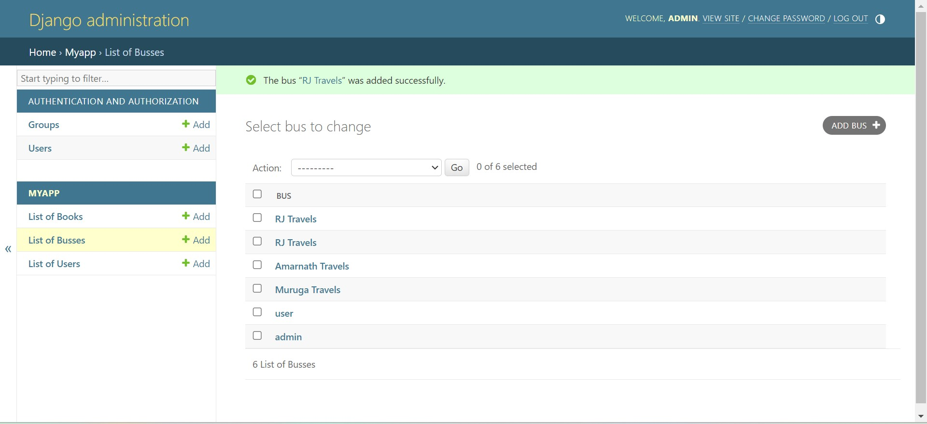
Blog-Page

Slide 16
Future Enhancements: Mobile Application Development: Develop a companion mobile application for iOS and Android platforms to extend the reach of the Bus Reservation System. Provide users with the flexibility to book tickets, track buses, and manage bookings directly from their smartphones.
Enhanced Real-time Tracking:
Integrate advanced GPS technologies such as geofencing and route optimization algorithms to improve real-time tracking accuracy.
Enable passengers to receive notifications about estimated arrival times, delays, and route changes.
Personalization and Recommendation Engine:
Implement machine learning algorithms to analyze user preferences, booking history, and travel patterns.

Slide 17
Conclusion
The Bus Reservation System serves as a testament to the power of Python and Django in developing robust, scalable web applications tailored to the transportation industry's unique requirements. By leveraging the versatility of Python for backend development and the rapid development capabilities of Django for frontend interfaces, the system delivers an intuitive, feature-rich experience for both passengers and service providers.
Source :

Slide 18
Thank You!
Notes:
Thank You !!

